Slide 1

Breast Cancer Prediction

Slide 2

Table of contents
01
03
introduction
Modeling
02
data
04
deployment

Slide 3
01
introduction

Slide 4

Breast cancer is a major health concern, and early detection is key to improving outcomes. While traditional methods like mammograms are useful, they have limitations. This is where artificial intelligence steps in. By using AI to analyze patient medical data, we can help in detecting cancer earlier and more accurately. We aim to enhance breast cancer prediction, aiming to support doctors in making quicker, more precise diagnoses, ultimately improving patient care.

Slide 5
02
Data section

Slide 6
All features :
ID
Diagnosis
radius_mean
texture_mean
perimeter_mean
area_mean
fractal_dimension_mean
radius_se
texture_se
perimeter_se
area_se
smoothness_se
compactness_se
concavity_se
concave_points_se
symmetry_se
fractal_dimension_se
compactness_mean
concavity_mean
concave_points_mean
symmetry_mean
smoothness_mean

Slide 7
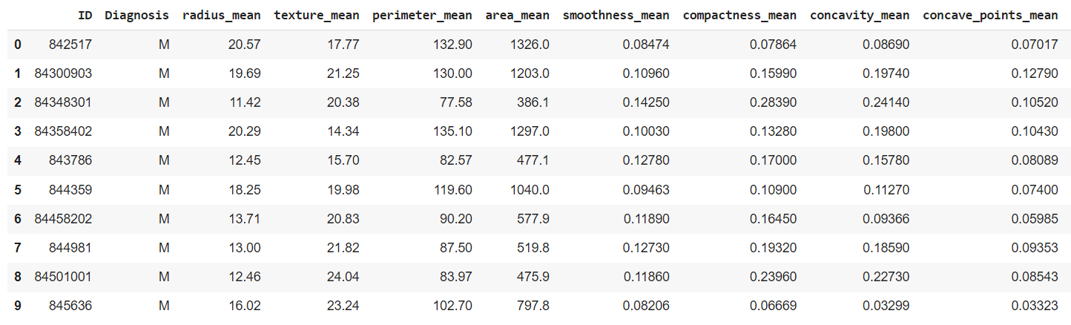
radius_worst
texture_worst
area_worst
perimeter_worst
smoothness_worst
compactness_worst
concavity_worst
concave_points_worst
symmetry_worst
area_worst
fractal_dimension_worst

Slide 8
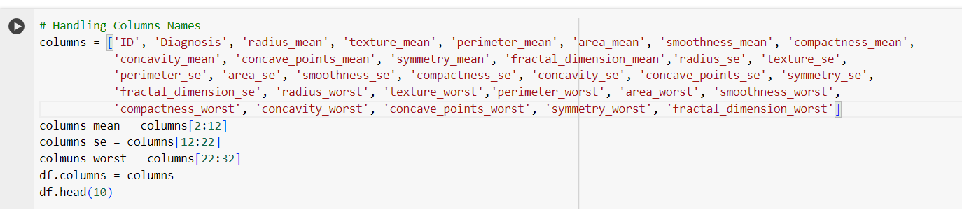
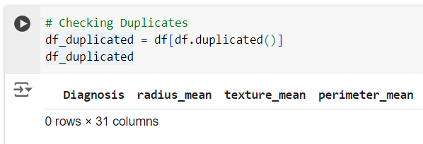
Data preprocessing :

Slide 9
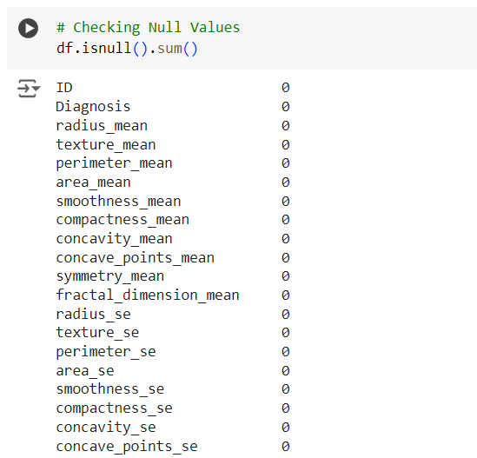
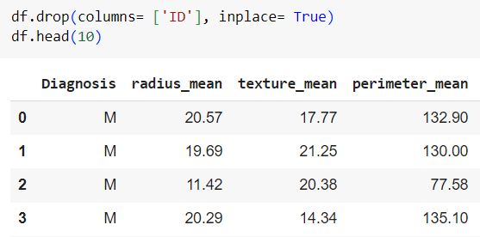

Slide 10
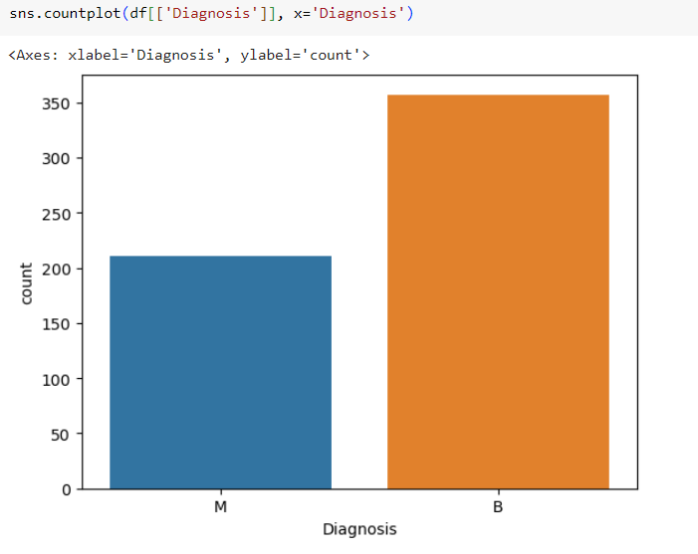
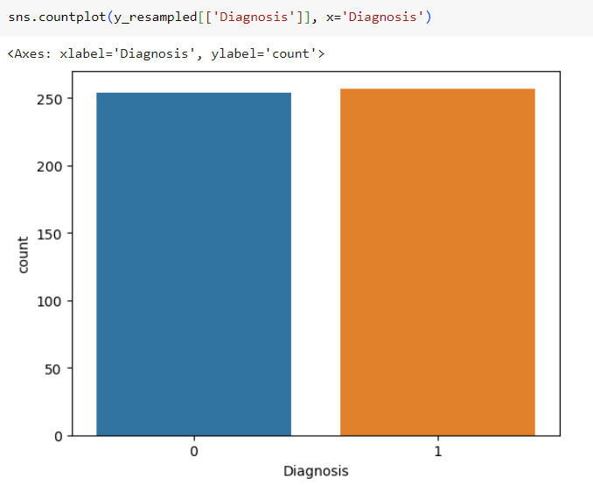

Slide 11
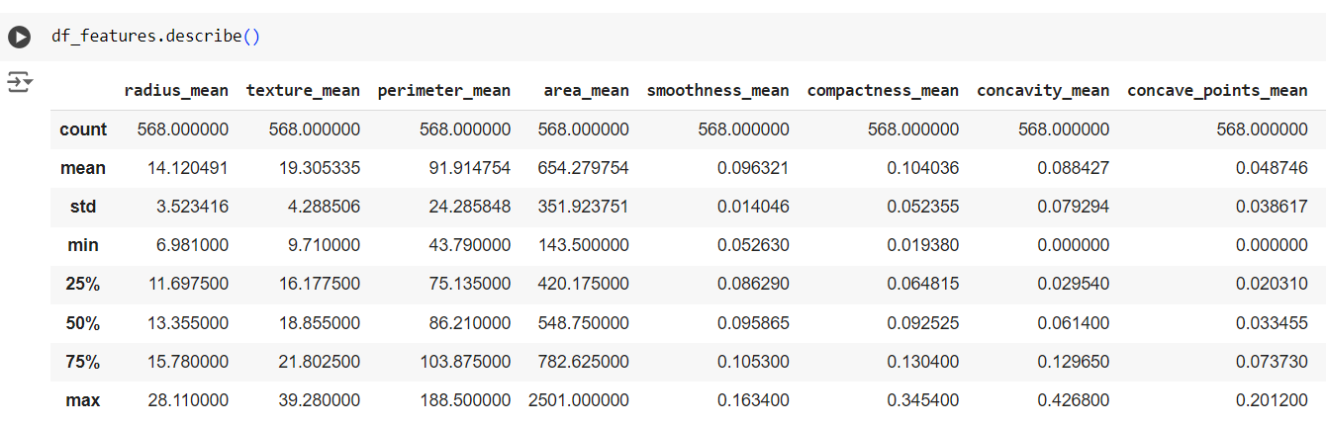
Data exploration and analysis :

Slide 12
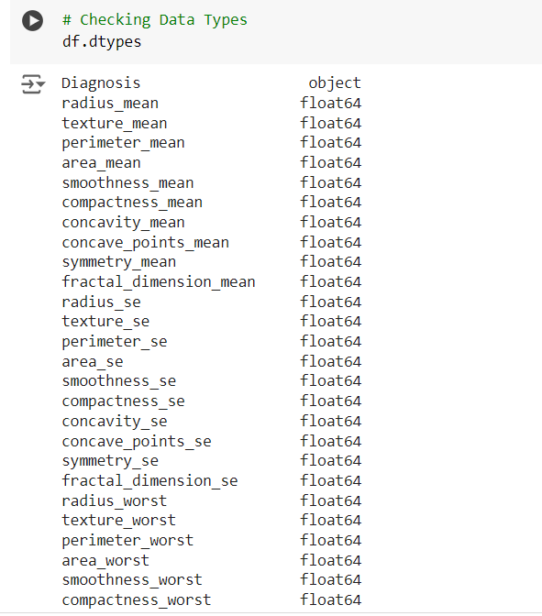
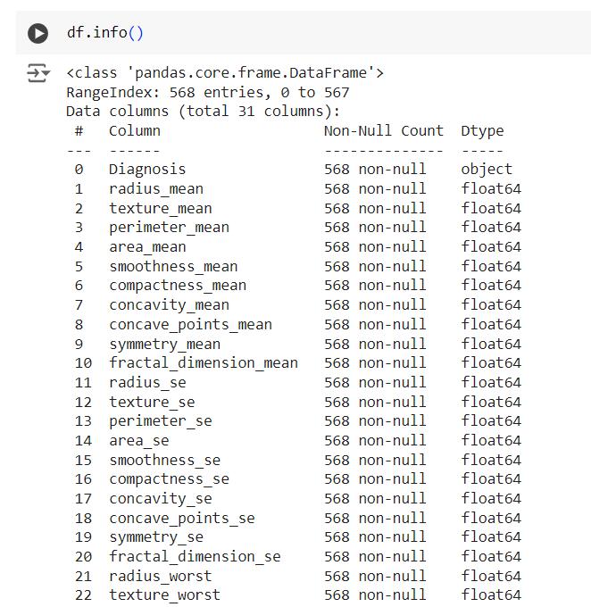
Data exploration and analysis :

Slide 13
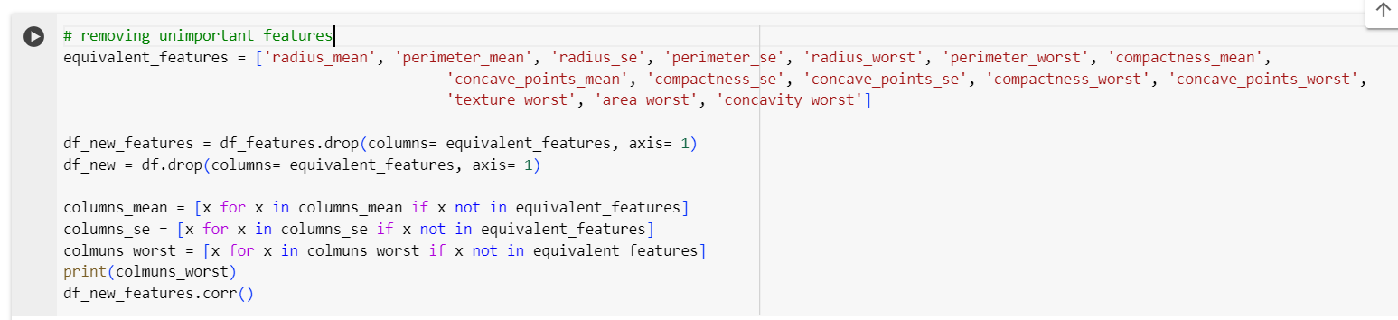
Data exploration and analysis :

Slide 14
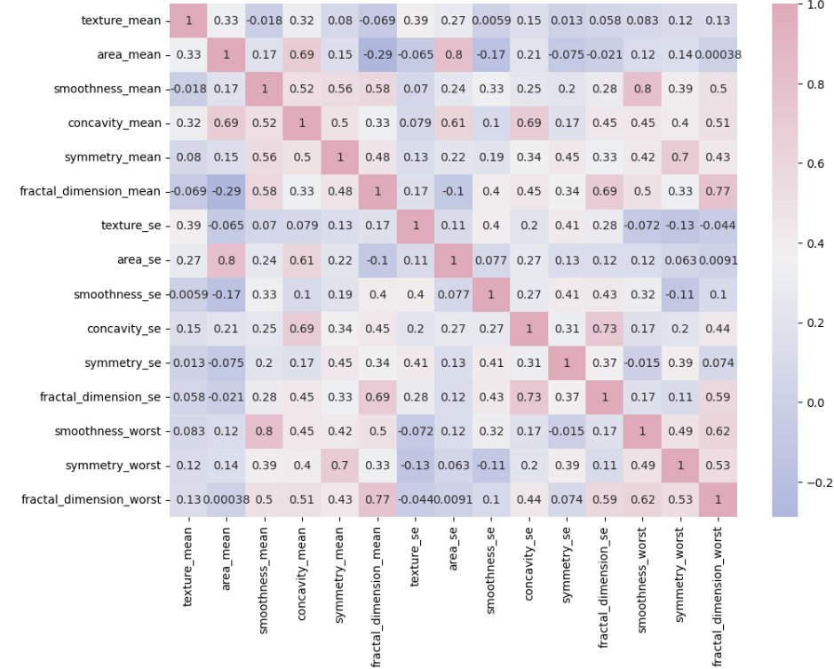
Data exploration and analysis :

Slide 15
03
Modeling

Slide 16
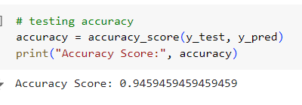
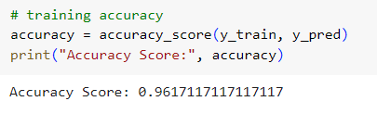
Logistic regression model :

Slide 17
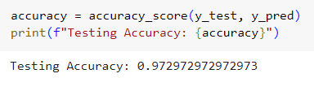

SVM model :

Slide 18
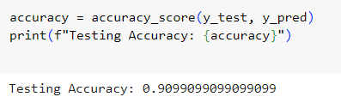
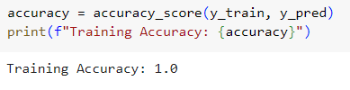
Decision tree model :

Slide 19
04
Deployment

Slide 20
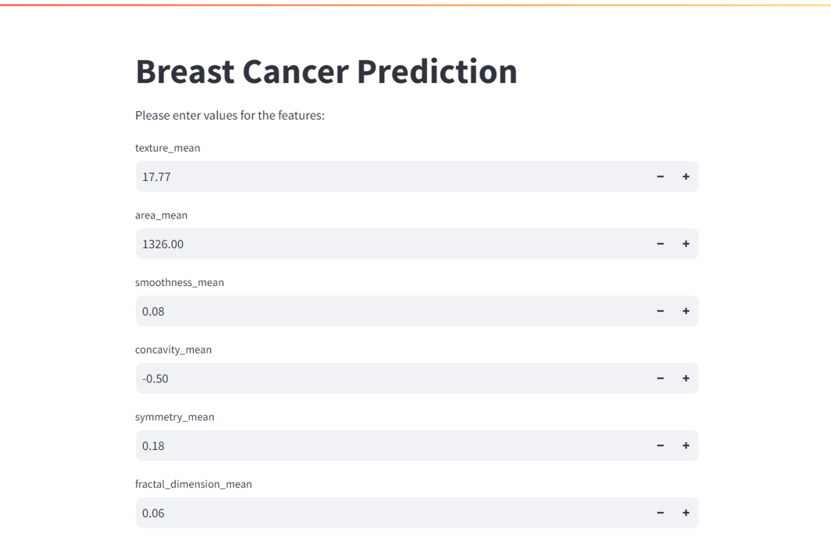
Deployment using streamlit :

Slide 21
Thank You

